Slide 1


Computer Applications to Behavioral Sciences
Lecture 9. Tuple
何吉波，博士
清华大学用户体验学科负责人
优视眼动科技公司创始人
http://www.usee.tech

Slide 2
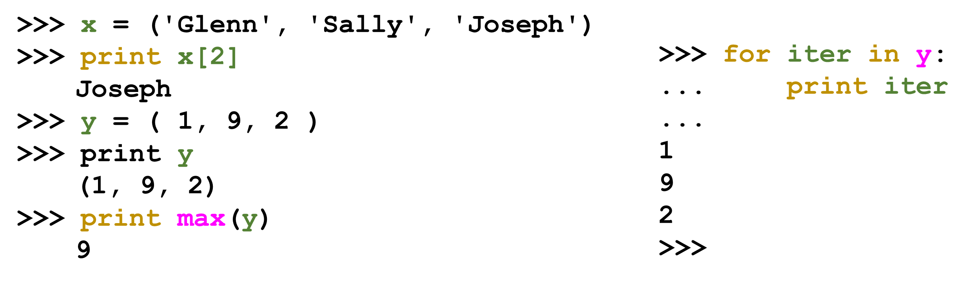
Tuples are like lists
Tuples are another kind of sequence that function much like a list - they have elements which are indexed starting at 0

Slide 3
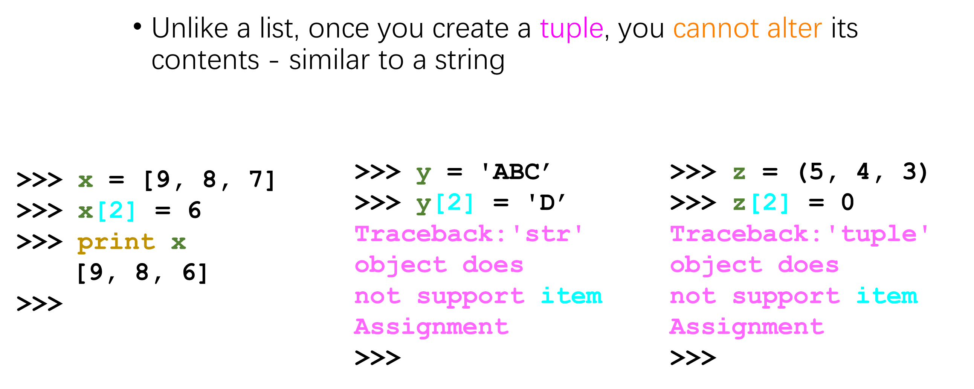
..but.. Tuples are "immutable"

Slide 4
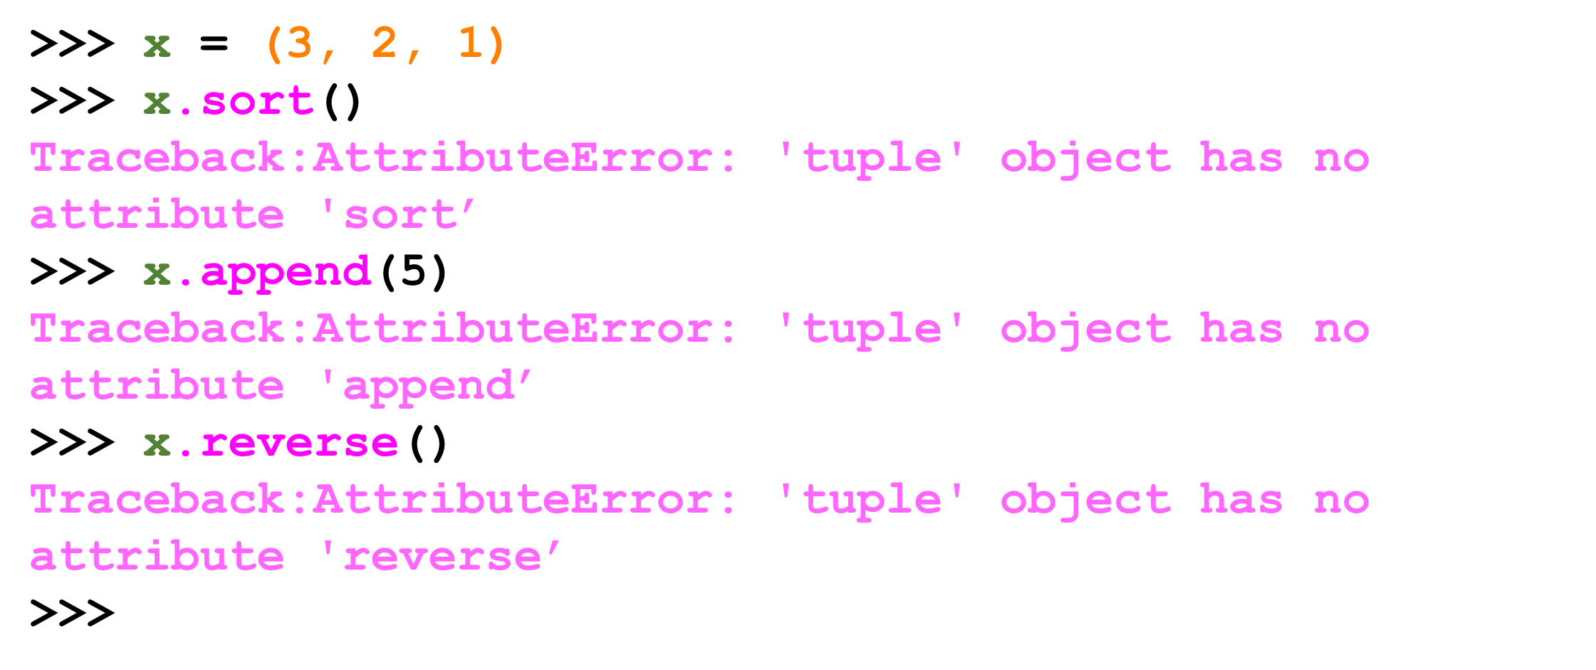
Things not to do with tuples

Slide 5
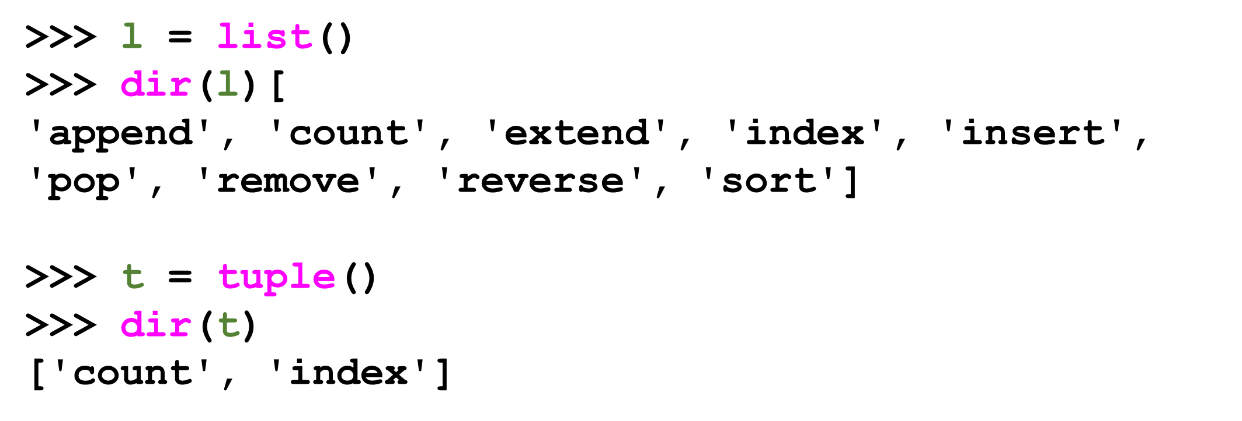
A Tale of Two Sequences

Slide 6
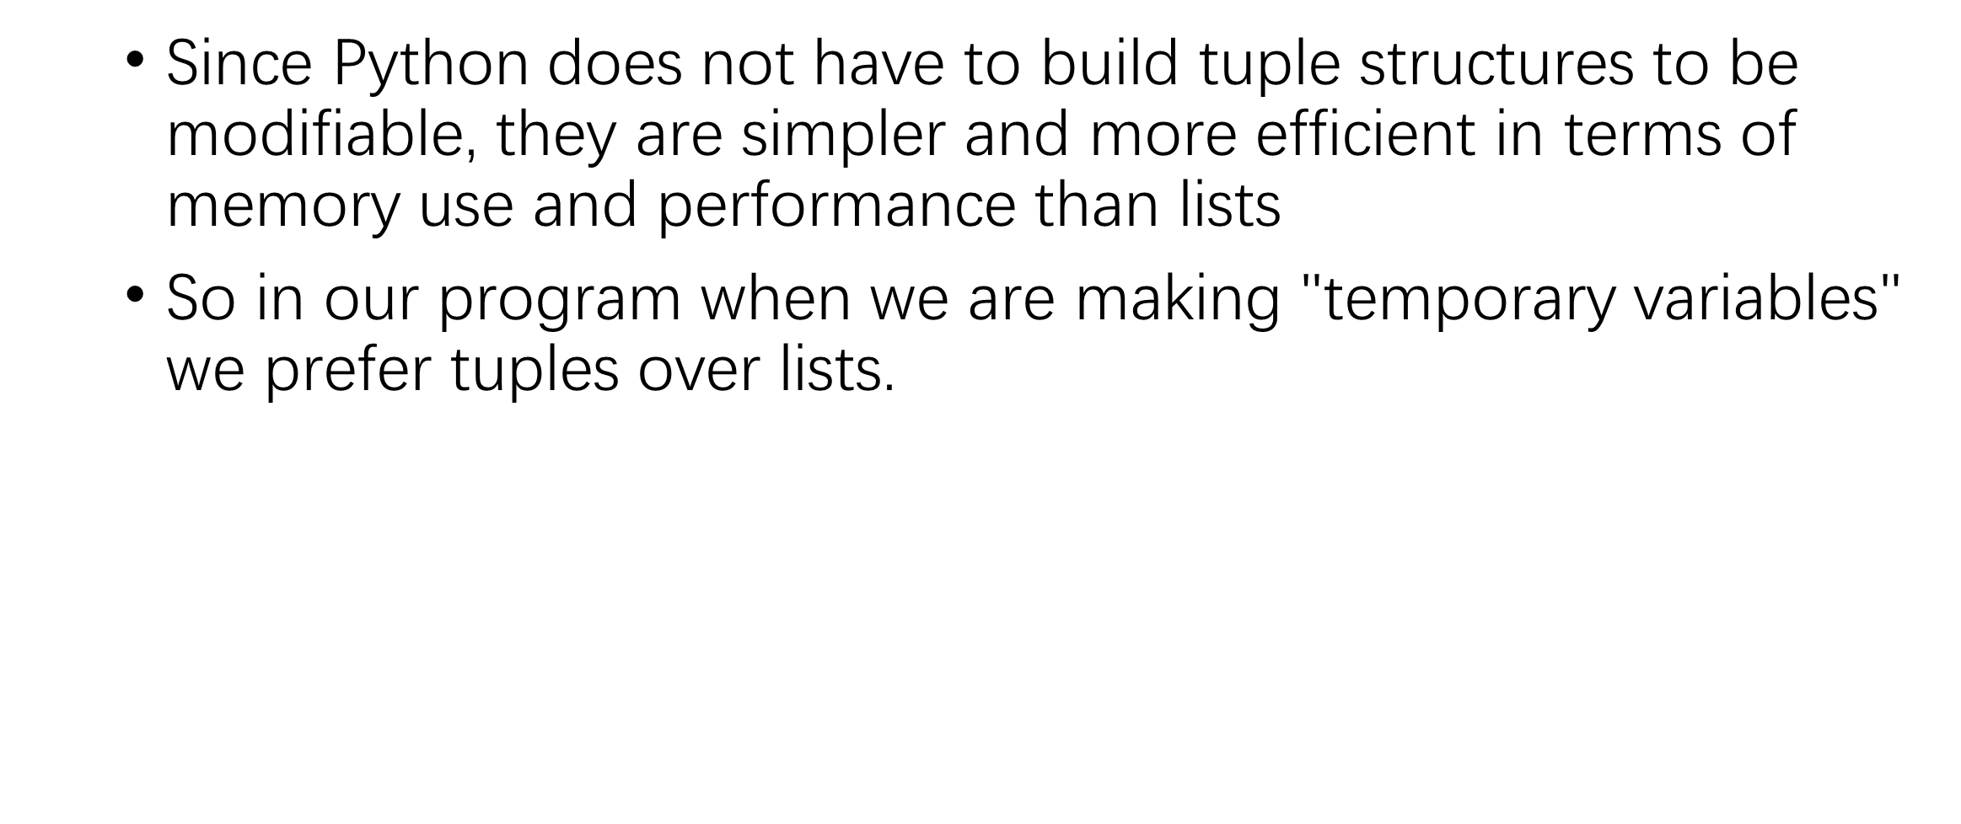
Tuples are more efficient

Slide 7
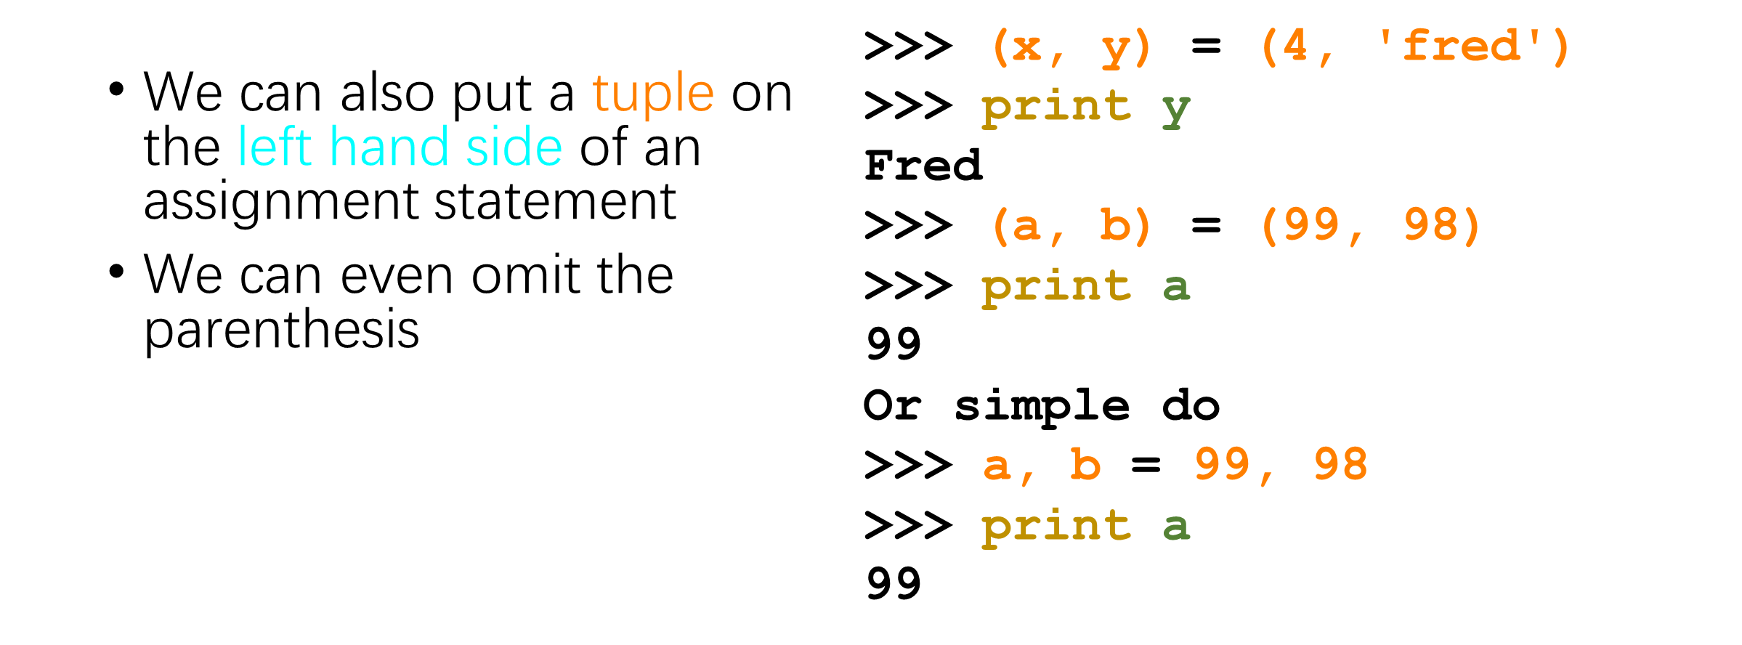
Tuples and Assignment

Slide 8
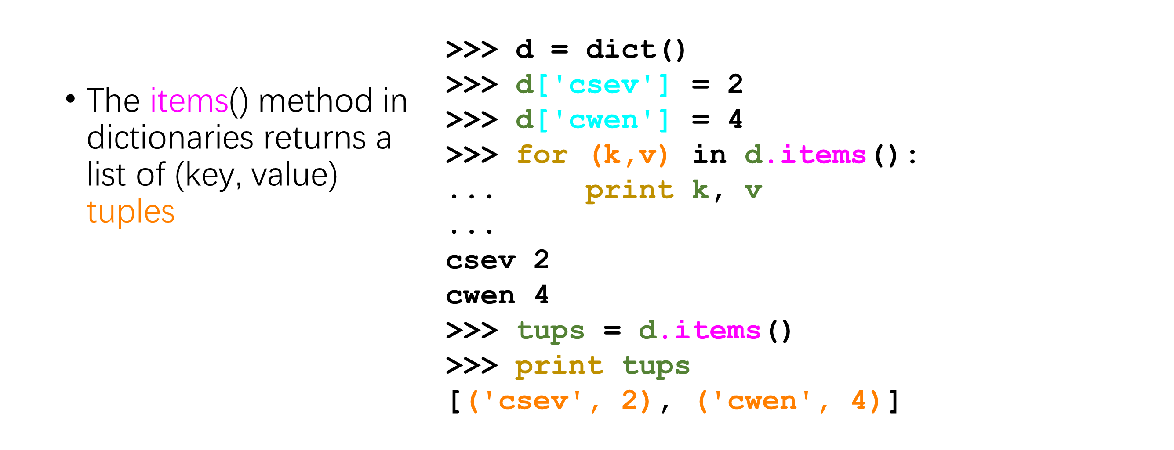
Tuples and Dictionaries

Slide 9
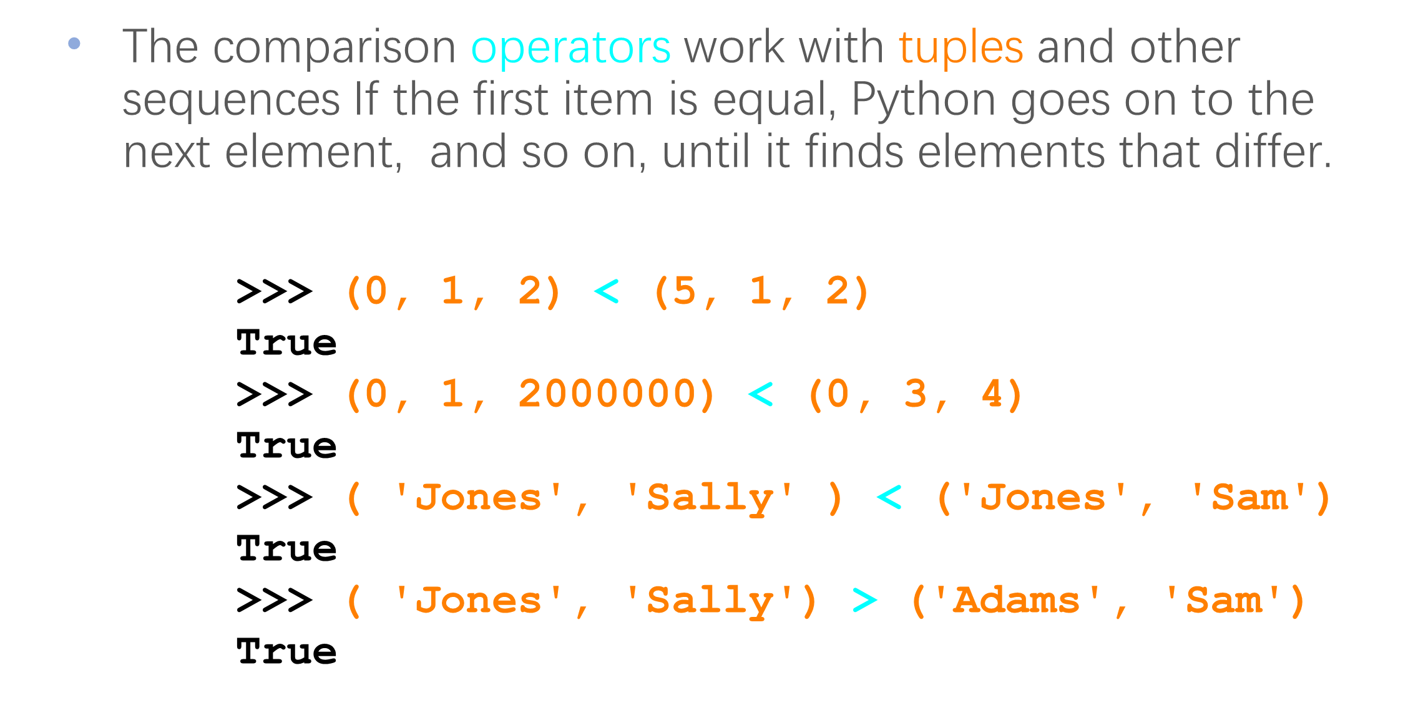
Tuples are Comparable

Slide 10
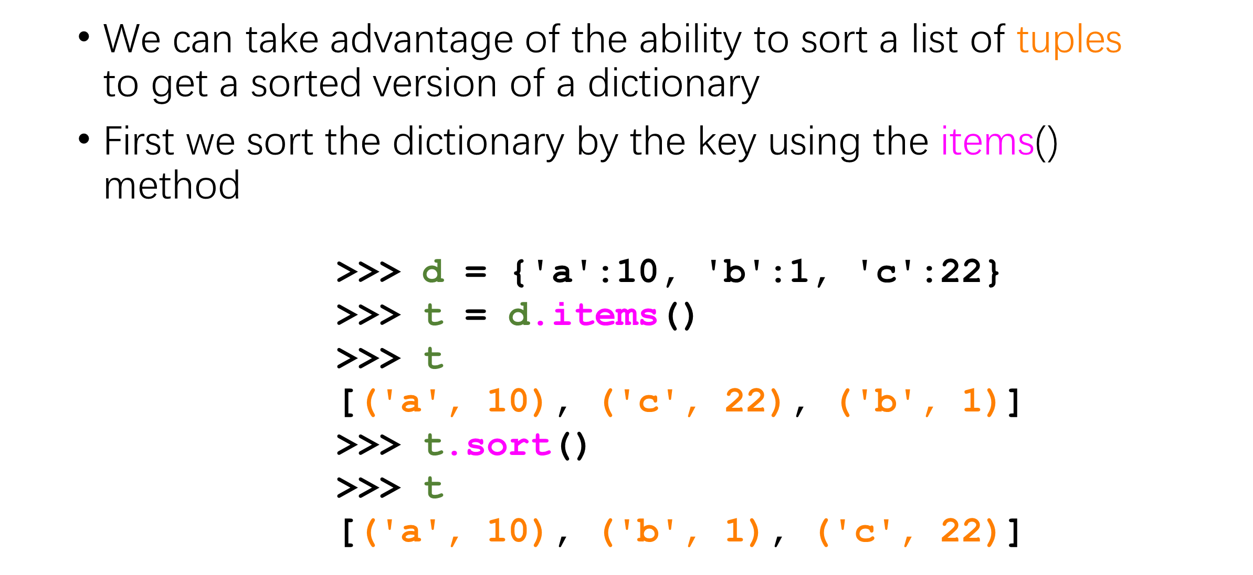
Sorting Lists of Tuples

Slide 11
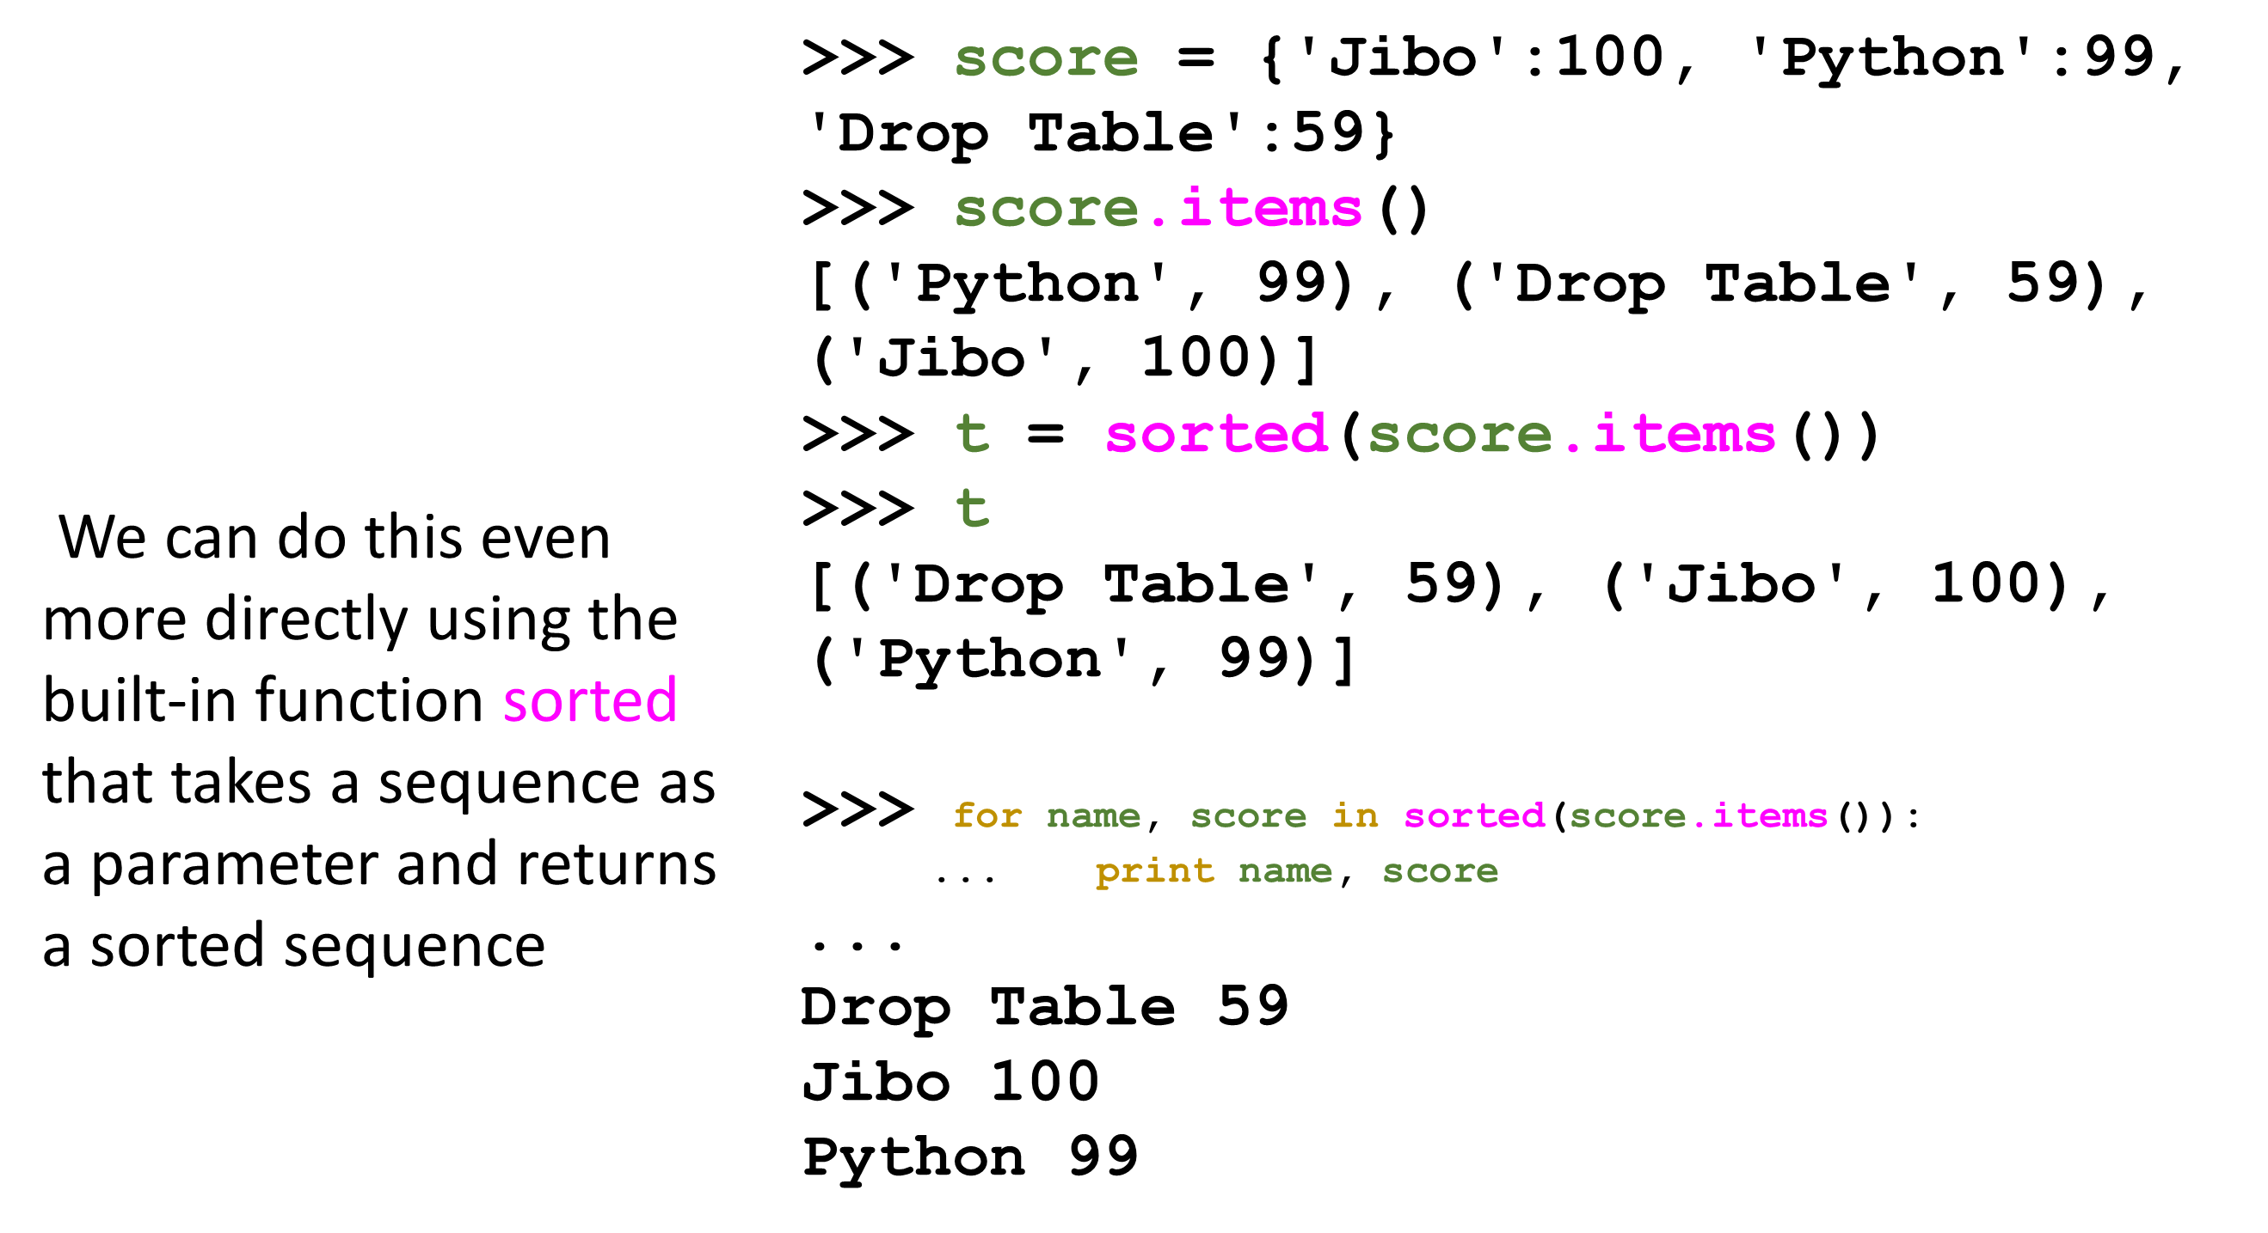
Using sorted()

Slide 12
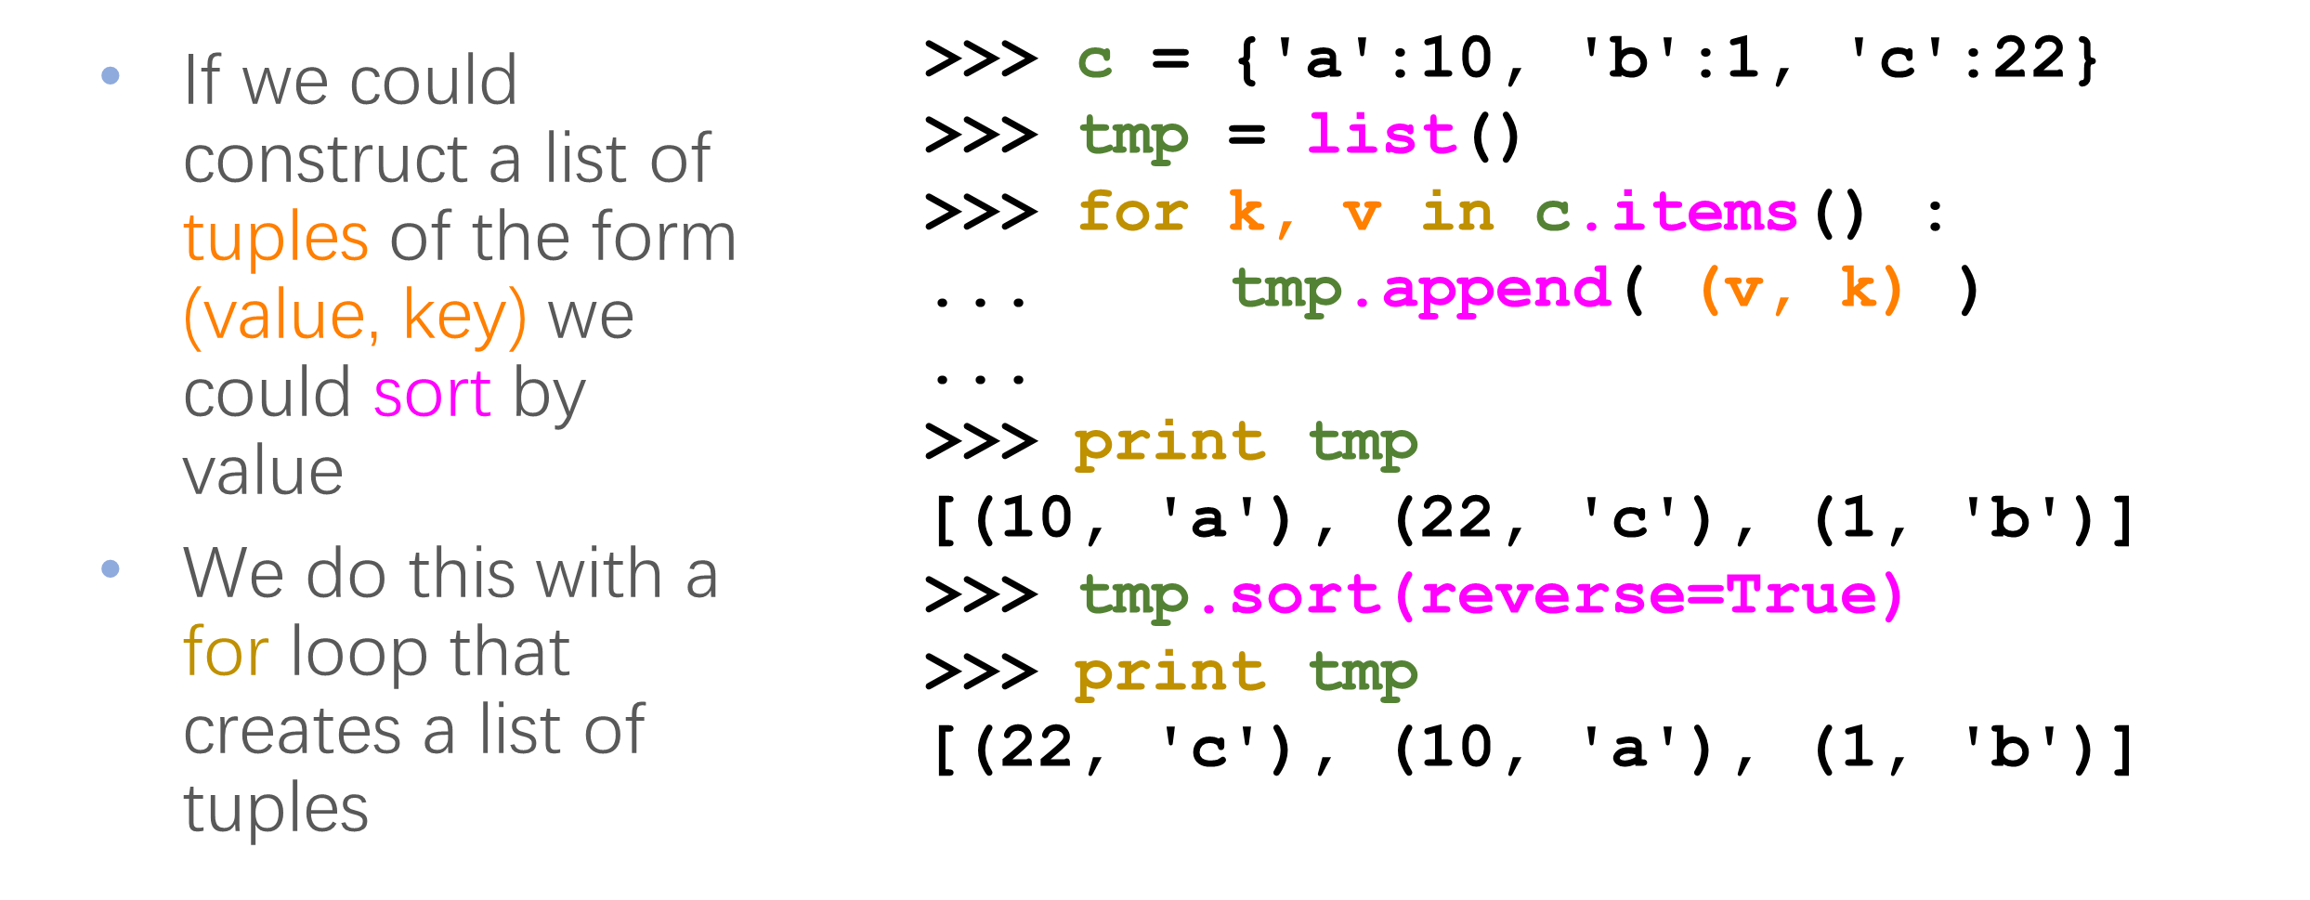
Sort by values instead of key

Slide 13
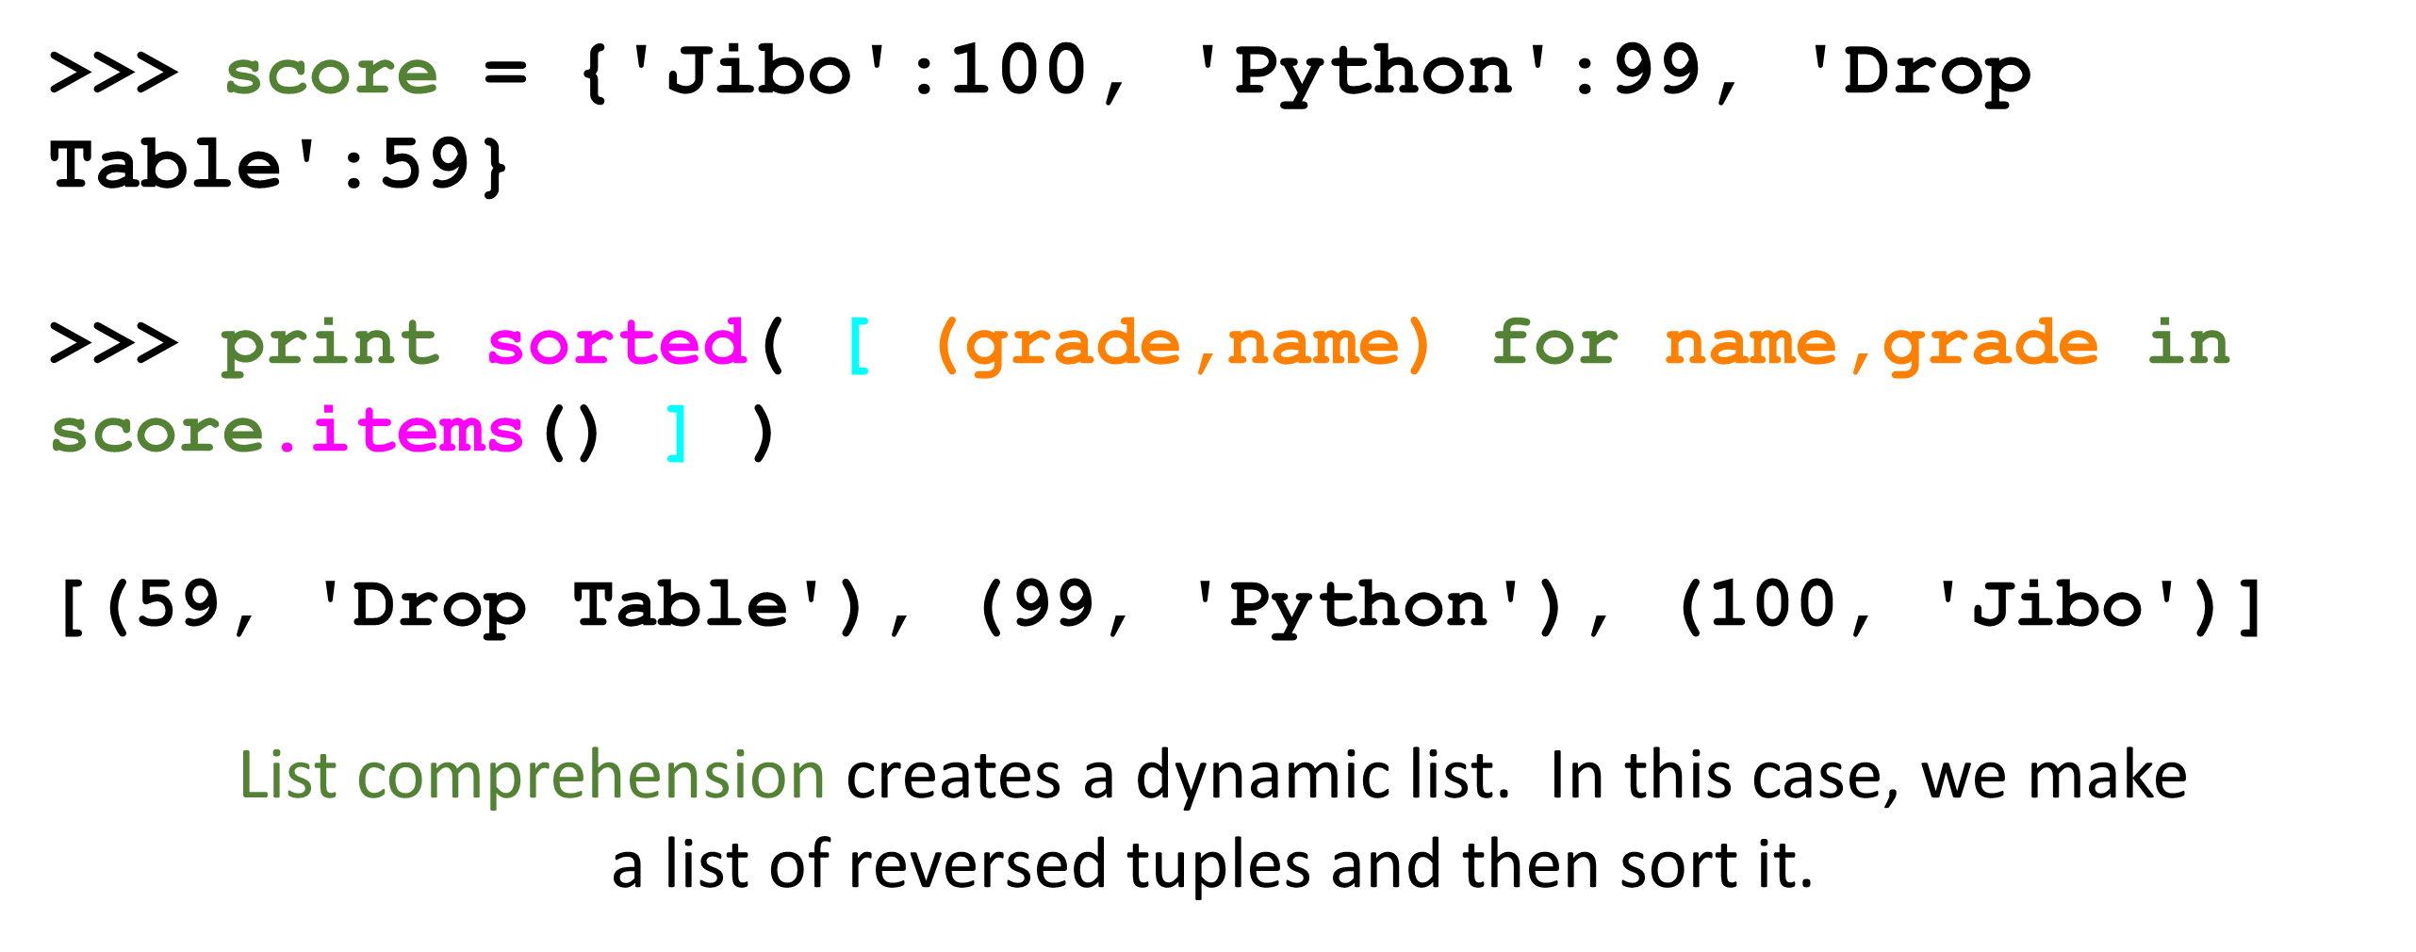
Even Shorter Version

Slide 14
Summary
Tuple syntax
Mutability (not)
Comparability
Sortable
Tuples in assignment statements
Using sorted()
Sorting dictionaries by either key or value

Slide 15
Thank You

